Slide 1
Recommended Practices for Anti-Retaliation Programs
Whistleblower Protection Program
Notes:
So today we are going to talk about how to build a culture where retaliation is not tolerated. We call this presentation “Recommended Practices for Anti-Retaliation Programs”
In your handouts: (optional. Use only if you will provide handouts).
“Recommended Practices for Anti-Retaliation Programs” guidance document has additional details about creating an effective anti-retaliation program. https://www.osha.gov/Publications/OSHA3905.pdf
“Whistleblower Statutes Desk Aid” which summarizes the 22 anti-retaliation statutes OSHA’s whistleblower program currently administers. https://www.whistleblowers.gov/whistleblower_acts-desk_reference
NOTE: This presentation and the guidance is advisory in nature and does not interpret or create legal obligations.

Slide 2
OSHA’s Whistleblower Protection Program
If worker raises a concern
Cannot
retaliate
Notes:
Before we talk about recommended practices, let’s talk about OSHA’s whistleblower protection program.
OSHA administers 22 federal statutes that protect covered persons (such as employees) from retaliation (such as firing or demoting) when they raise or report concerns about hazards or violations of various laws (such as raising a legitimate safety concern) in any one of the following areas:
Workplace safety & health
Transportation safety (airplanes, trucks, railroads, buses, ships, intermodal containers, motor vehicle manufacturing, & gas pipelines)
Food Safety (covers entities that manufacture and process food)
Corporate Fraud & SEC Rule Violations (covers entities, such as banks, that must comply with regulations from the Consumer Financial Protection Bureau and/or the Securities and Exchange Commission)
Consumer Protections (such as consumer product safety or health insurance reform)
Environmental safety and nuclear energy (complaints about clean water and air, for example, are docketed under these statutes)
In sum, if a covered person, usually an employee, raises a concern covered under one of these 22 statutes, then you cannot retaliate against him/her.
Here’s an example:
An employee was working as a manager in the financial industry, and was fired after reporting banking improprieties. OSHA found that the employee’s reporting of these improprieties contributed to the employee’s termination. In addition to ordering reinstatement of the whistleblower's job and awarding back pay, compensatory damages and attorneys' fees; the employer must clear the employee’s personnel file. The bank is also required to post notices informing bank workers about federal whistleblower protection laws.

Slide 3
Why recommended practices?
Preventing retaliation is …..
Wo
good for workers
good for business
Notes:
So, what is the point of recommended practices? Our goal in developing this material is to help employers develop policies that create a company culture where retaliatory practices are not tolerated and to spread the message that preventing retaliation is good for workers and good for business.
An anti-retaliation program that enables all members of the workforce, including permanent employees, contractors and temporary workers, to voice their concerns without fear of retaliation can help employers learn of problems and appropriately address them before they become more difficult to correct.
Proactive (effective) anti-retaliation programs are designed to:
receive and respond to employees’ compliance concerns (i.e. concerns about hazards or potential violations of any of the 22 statutes OSHA administers)
prevent and address retaliation against employees who raise or report concerns.
Additional benefits of a program based on this proactive approach:
Helps employers ensure that they are following federal laws.
Helps create a positive workplace culture that prevents unlawful retaliation against employees.
Improves employee satisfaction and engagement.
Helps protect workers and members of the public from the harm of violations of federal laws and regulations.

Slide 4
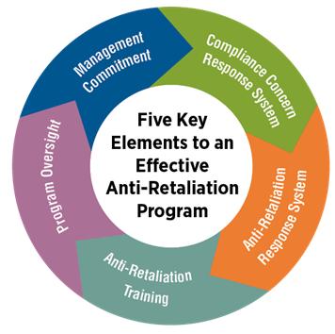
Key Elements
Notes:
(Graphic used in guidance document.)
There are 5 key elements to creating an effective anti-retaliation program:
Management leadership, commitment and accountability
Creating a system for listening to and resolving employees’ safety and compliance concerns
Creating a system for receiving and responding to reports of retaliation
Providing anti-retaliation training for employees and managers
Finally, developing & implementing a plan for strong program oversight
In order to effectively support employee reporting and protect employees from retaliation, employers should integrate all five elements into a cohesive program.

Slide 5
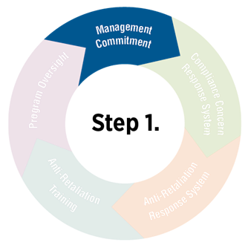
Management Commitment
Implement system
Ensure confidentiality
Enforce requirements
Evaluate program
Notes:
Management leadership, commitment and accountability
Recommended practices work only when senior management demonstrate leadership and commitment to anti-retaliation efforts.
Our goal is to create a company culture where subordinates are free to raise concerns under any of the statutes OSHA administers without fear of losing their jobs, or being demoted, or being subjected to any other form of retaliation.
Step #1: Implement a system for reporting compliance concerns.
Ensure that your systems to report hazards, compliance concerns, and retaliation allow your employees to maintain confidentiality. Why is this important? OSHA whistleblower investigators sometimes find that when an employee makes a legitimate safety complaint to the person who has the authority to hire or fire, he or she is then retaliated against (ex. fired).
Also ensure that a senior manager, who has access to the top leadership (and board of directors, where applicable), implements this system and enforces its requirements. Do you remember the example I read about the bank. They had an internal hotline where employees could raise complaints. I suspect that this employer could have strengthened its anti-retaliation program if there was a senior manager who had authority to enforce the program’s requirements and to report concerns to the top leadership.
Routinely evaluate whether your system is working. This is an important step. Evaluate the program’s effectiveness on an on-going basis. Ensure that there is a mechanism for accurately evaluating employees’ willingness to report concerns about the workplace and the employer’s actual record in preventing retaliation against employees who report. Also ensure that there is a means for accurately reporting to top management the results of such evaluation.

Slide 6
Management Commitment
Back-up words with action
Lead by example
Accountability
Anti-retaliation system
Notes:
How can leaders demonstrate commitment to supporting a culture where retaliation is not tolerated?
Step #2: Back up words with (consistent) actions and responses. For example, if your company has a zero tolerance for violence policy, follow it without exception. For example, I am aware of one whistleblower investigation where a low level worker accused her supervisor of assaulting her after she attempted to report a work-related injury. After an internal investigation, multiple witnesses confirmed the supervisor hit the low level worker. This company had a “zero-tolerance” policy for fighting and violent acts.
So, how do you think senior leadership should react in this situation?
In this case, a real one, the woman who attempted to report a workplace injury was fired. The person who committed the assault was promoted. This is a situation where senior leadership did not back up words with actions. Here, under the Occupational Safety & Health Act of 1970, the employee had a right to report a workplace injury. Not only did the company unlawfully retaliate against this employee – they fired her – the company violated the terms of the policy they created. The supervisor who assaulted the employee should have been disciplined, but instead was promoted. Words without consistent actions are meaningless.
Step #3: Managers at all levels should be held accountable for the quality of their response to employees’ concerns, including reports of potential violations of the law, of safety hazards, and of retaliation.
How can management be held accountable for preventing retaliation?
Incorporate anti-retaliation measures (e.g., promptly and constructively addressing employee concerns, attending training, and championing anti-retaliation initiatives) in management performance standards and reviews.
• Implement strong codes of conduct and ethics programs that clearly identify whistleblower retaliation as a form of misconduct to ensure anti-retaliation policies and practices are enforceable.
• Apply appropriate consequences, such as discipline, to managers who retaliate or who violate the confidentiality of an employee who has made a report. These consequences should be sufficient to serve as a deterrent to future acts of retaliation.

Slide 7
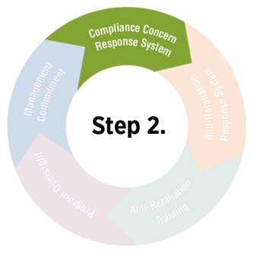
Compliance concerns response system
Listen
Evaluate
Timely
Respond
Notes:
Element #2 – Create a system for listening to and resolving employees’ safety and compliance concerns
To help prevent retaliation, employers should proactively foster an organizational culture in which raising concerns about workplace conditions and activities is valued. Employers can cultivate such an environment by listening to and resolving employees’ compliance concerns.
Key elements to consider when creating such a system:
Establish procedures that enable employees to report concerns (including through confidential or anonymous channels, when possible).
Ensure you evaluate complaints or concerns fairly and transparently. Your staff must understand why you thought their complaint did/did not have merit.
Timely respond to complaints – do not take too long to answer complaints. Give employees a timeframe to resolve.
Ensure fair and effective resolution of complaints. Hire an independent 3rd party, if necessary, to review reports of concerns promptly, thoroughly, and with transparency, including responding to the employee who brought forward the initial concern.
** Important ** Ensure your program does not restrict or discourage employees from reporting allegations. For example, employer policies must not discourage employees from reporting concerns to a government agency, delay employee reports to government, or require employees to report concerns to the employer first.

Slide 8
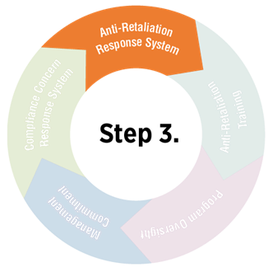
Respond to reports of retaliation
Independent reporting channel
Notes:
Element #3 – Create a system for receiving and responding to employees’ reports of retaliation.
Employees who believe they have been retaliated against should:
Have independent channels to report retaliation.
Not be required to report to the manager who they believe retaliated against them. Allow employees to elevate to a person not in their chain of command.
Be aware of the procedures for reporting retaliation. There should be clearly defined roles and responsibilities for managers at all levels and others who are involved in responding to reports of retaliation, such as human resources or ethics and compliance personnel. The procedures should be known and accessible to all.
When retaliation is reported, employers should investigate the claim promptly and thoroughly, utilizing an established retaliation response system.
Such investigations should:
Take all reports of retaliation seriously.
Investigate claims using an objective, independent complaint review process.
Keep the reporting employee and management representatives informed of developments throughout the investigation and ensure respectful, proper closure of the issue.
After the reported problem has been investigated and resolved, periodically follow up with the reporting employee for a reasonable amount of time to ensure continued protection from retaliation.

Slide 9
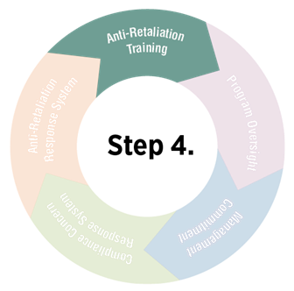
Train Employees
Protections
Procedures
Emphasize Commitment
Notes:
Element #4: Effective training of employees and all levels of management is key to any anti-retaliation program.
Training is essential because it provides management and employees with the knowledge, skills, and tools they need to recognize, report, prevent, and/or properly address hazards, potential violations of the law, and retaliation.
For employees:
Define retaliation. What is it? Retaliation occurs when a person with authority takes an adverse action, such as firing or demoting, because the employee engaged in an activity protected by law, such as raising a concern about workplace safety. Employees must understand what retaliation is.
Summarize relevant employees’ rights and obligations as well as statutory rights to be protected from retaliation for reporting potential violations.
Take a look at the Whistleblower Statutes Desk Aid. There are 22 different statutes. Choose the ones most relevant to your business. For example, if you are a toy manufacturer, then the Occupational Safety and Health Act and the Consumer Product Safety Improvement Act probably apply to the workers in your business. Whistleblowers who report violations of these laws are protected from retaliation.
Describe how your anti-retaliation program works.
Explain the elements of the employer’s anti-retaliation program, including roles and responsibilities, how to report concerns internally and externally, options for confidential or anonymous reporting, and how to elevate a concern internally when supervisors or others do not respond.
Emphasize you commitment to the anti-retaliation program.
Explain the employer’s commitment to creating an organizational culture of complying with the law, addressing concerns from all members of the workforce about potential hazards and violations of the law, and complying with its code of ethics, including prohibitions on retaliation.

Slide 10
Train Managers
Diffuse conflict
Respond appropriately
Clarify consequences
Notes:
Element #4: Effective training of employees and all levels of management is key to any anti-retaliation program.
For managers, give them the training employees receive but add:
Skills for defusing conflict, problem solving, and stopping retaliation in a work group.
Do you remember the example I gave earlier where the supervisor hit the employee after she attempted to report a work-related injury? This is an example of where giving managers tips to diffuse conflict - such as really listen to the complainant and understand what he or she is trying to say – would be useful.
How to respond to a report of a workplace concern while protecting an employee’s confidentiality and without engaging in retaliation, appearing to engage in retaliation, or questioning the motives for the report.
How to separate annoying or inappropriate behavior from the concern itself.
Consequences for managers who fail to follow anti-retaliation policies or respond to concerns inappropriately.
For example, you might inform your supervisors that they will be disciplined, without exception, if it is established he/she retaliated against an employee for raising a legitimate safety concern.
How to recognize that an employee believes there has been retaliation, when employers are required to act, and the potential legal consequences the employer and the manager face for inaction.

Slide 11
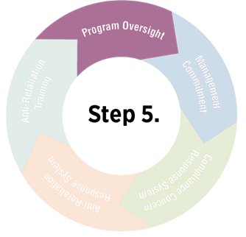
Program Oversight
Monitoring
Auditing
Notes:
Element #5: A well-designed anti-retaliation program needs rigorous oversight to ensure that it is efficient, effective, and working as intended.
Monitoring and auditing are two forms of oversight that can help employers gain insight into a program’s strengths and weaknesses and reveal whether program improvements are needed.
Monitoring is an ongoing analysis of whether your anti-retaliation program processes in place are achieving the organization’s planned results and program goals. Perhaps you can conduct anonymous surveys and interviews of employees who reported compliance concerns or retaliation; narratives from injury or error reports; case studies of investigated issues and responses; claims department or risk management case files related to injuries or errors; and complaint files relating to reporting requirements.
Auditing is an independent, formal, and systematic approach designed to determine whether the anti-retaliation program processes are efficient (are employees’ compliance or retaliation concerns investigated in a timely manner), effective (are your incidents of accidents decreasing), and working as intended (are employees speaking up). Are managers following program policies?
NOTE: Audits should be conducted by individuals who are independent of the process being audited.
How should employers use the results or findings of program oversight?
The results of oversight activities like monitoring and auditing should be reported directly to the top managers and the board (if applicable). The results should also be shared with all levels of management and the workers covered by the program.
Employers should use monitoring results as a basis for program improvements and accountability.

Slide 12
Scenario
Notes:
Let’s go through an example. Please read along with me. (Scenario could be provided as a handout.)
Alicia Olmedo worked for Poppy Corn, a craft popcorn manufacturer, as a production worker from January 11, 2011 until May 2, 2013. Sometime in March of 2013, Ms. Olmedo began working with a pickle spice seasoning. From April 8 – 22, 2013, Ms. Olmedo repeatedly raised concerns to her supervisor about working with the pickle spice compound, including reporting headaches, nosebleeds and rashes. She also asked to review the safety data sheets. On April 24, 2013, a frustrated plant manager for Poppy Corn assaulted Ms. Olmedo after she complained. The plant manager also informed Alicia and other employees that she no longer wanted to hear complaints about the pickle spice compound. The Plant Manager fired Complainant on May 2, 2013, by telephone. This company did not have a formal complaint process.

Slide 13
Scenario Questions
Question 1: Did Alicia Olmedo raise a concern that was protected by any law administered by OSHA’s Whistleblower Protection Program?
Question 2: Did anyone at Alicia’s worksite retaliate against her? If yes, name the retaliatory action.
Notes:
Question 1: Did Alicia Olmedo raise a concern that was protected by any law administered by OSHA’s Whistleblower Protection Program?
Answer: Yes. Section 11(c) of the OSH Act allows employees to raise safety and health concerns without fear of retaliation. Alicia engaged in protected activity when she reported her health concerns and asked to review the safety data sheet for the pickle spice compound.
Question 2: Did anyone at Alicia’s worksite retaliate against her? If yes, name the retaliatory action.
Answer: Yes, the plant manager fired Alicia after she complained about health issues associated with workplace exposure to the spice compound.

Slide 14
Scenario Questions
Question 3: Do you think this company had a culture that valued employees’ concerns?
Question 4: If this company wanted to create an environment where retaliation is not tolerated, what can they do?
Notes:
Question 3: Do you think this company had a culture that valued employees’ concerns?
Answer: Probably not, since the plant manager’s actions of assault followed by termination of Alicia appeared to be retaliatory in nature for this employee raising safety and health concerns to management.
Question 4: If this company wanted to create an environment where retaliation is not tolerated, what can they do?
Possible Answers:
Develop and implement an anti-retaliation program and make sure all managers demonstrate a firm commitment to these efforts. In addition to leadership and commitment, managers must be held accountable for preventing retaliation in the workplace.
Create a system for listening to and resolving employees’ safety and compliance concerns. This includes establishing multiple channels for employees to report concerns while protecting the confidentiality and anonymity of the employee.
Create a system for receiving and responding to employees’ reports of retaliation. Managers must demonstrate that they take all reports of retaliation seriously.
Provide effective anti-retaliation training to employees and all levels of management; emphasizing to managers various techniques on how to diffuse situations and appropriately respond to reports of workplace concerns.
Maintain rigorous oversight of the anti-retaliation program to be sure it is working as intended.

Slide 15
Resources
Recommended Practices for Anti-Retaliation Programs
Whistleblower Statutes Desk Aid
www.whistleblowers.gov
Questions? Call the Directorate of Whistleblower Protection Programs in Washington, DC at (202) 693-2199
Call 1-800-321-OSHA (6742) or visit www.osha.gov/html/RAmap.html to reach a local OSHA office
Notes:
Primary resources are listed for further information on this topic.

